Slide 1
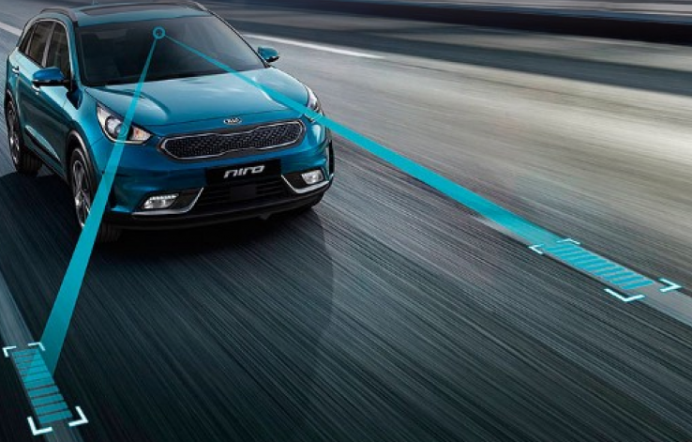
Lane Detection
Made by team Bošković
SI
MP
MM
VG
SB

Slide 2
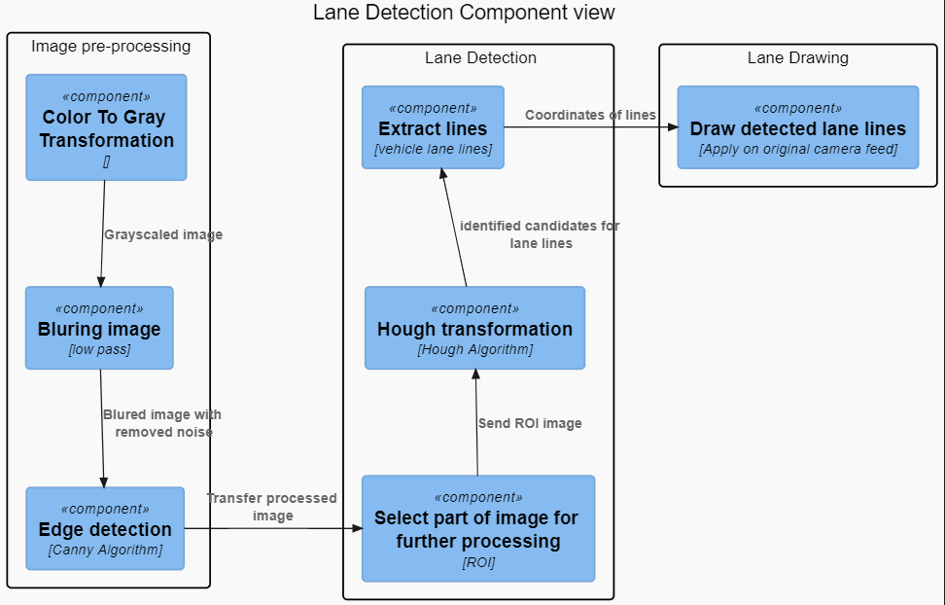

Slide 3
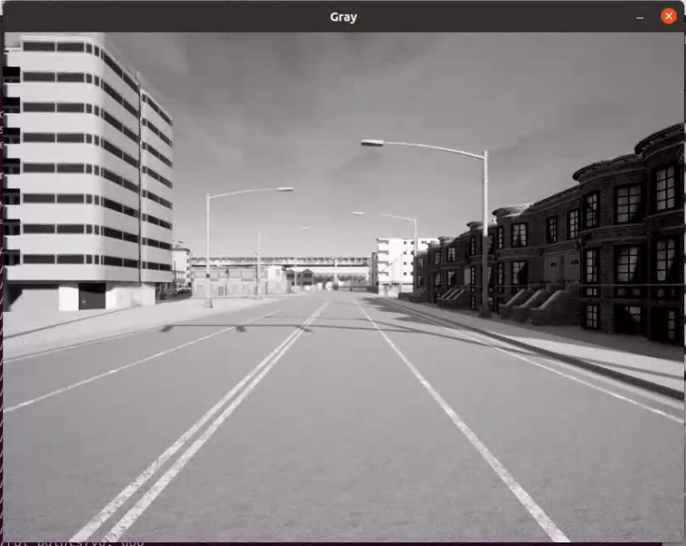
Color To Gray
Raw camera frame from front view camera

Slide 4
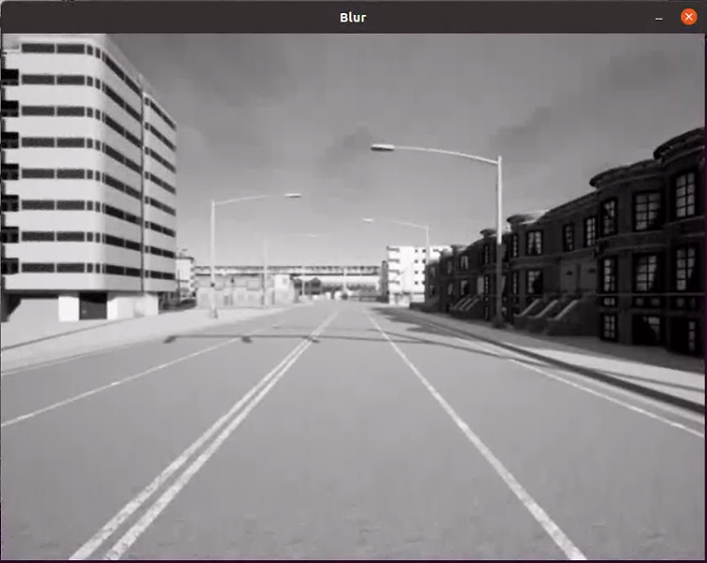
Blur image
After Gaussian filter

Slide 5
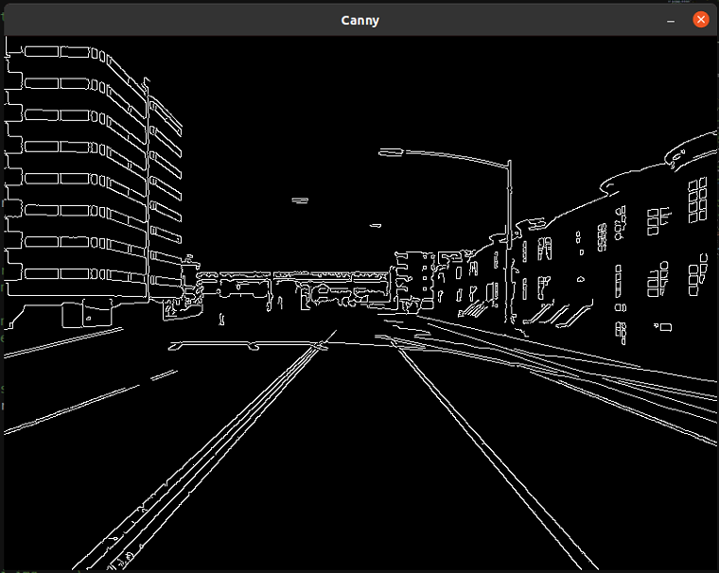
Canny Alghorithm
After Canny algorithm

Slide 6
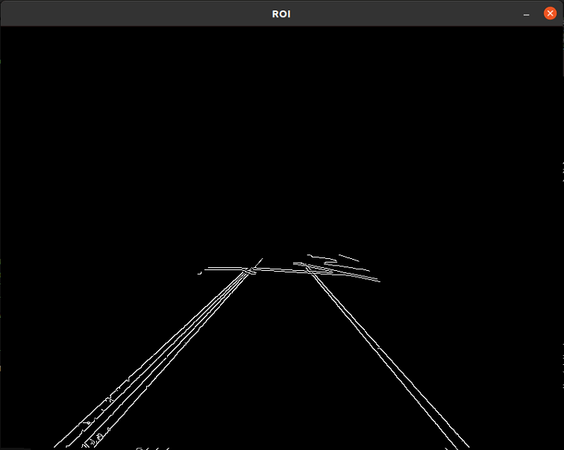
ROI (Region of interest )
After masking image

Slide 7
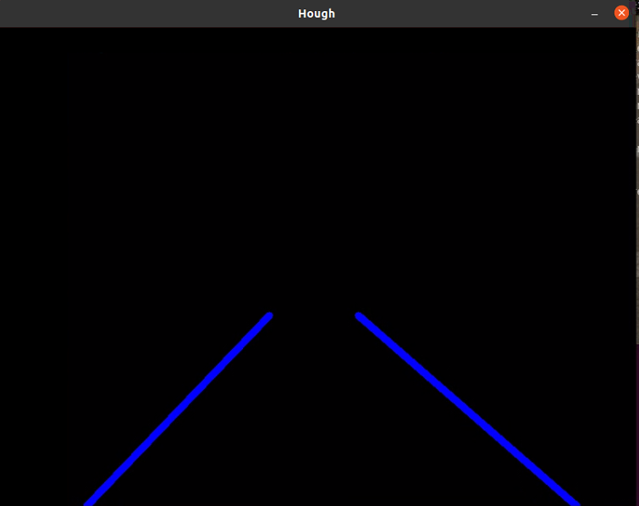
Hough algorithm Extrapolation lane lines
After Hough algorithm and extrapolation lines

Slide 8
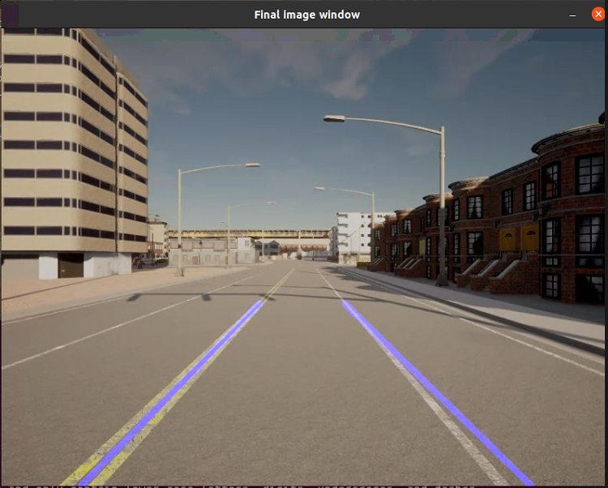
Finale image
Merging lines with original image

Slide 9
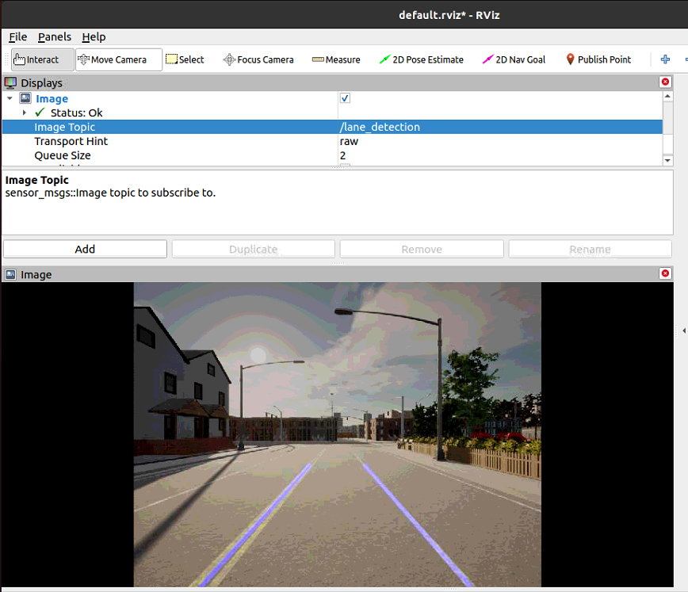
Publishing the image

Slide 10
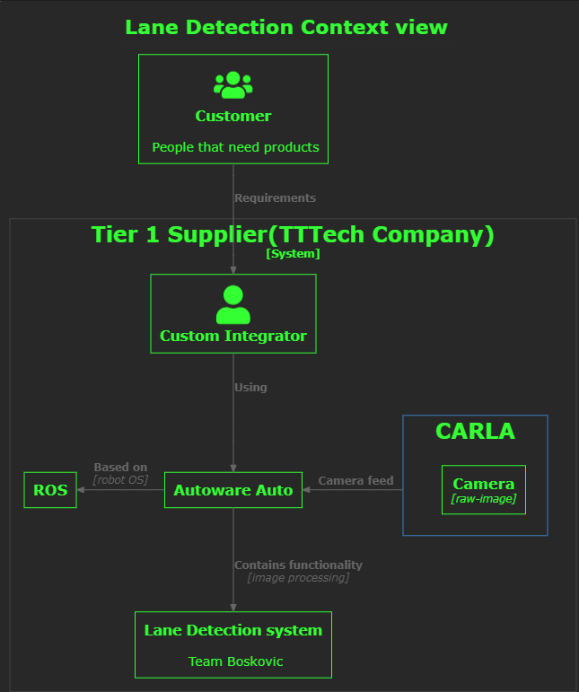
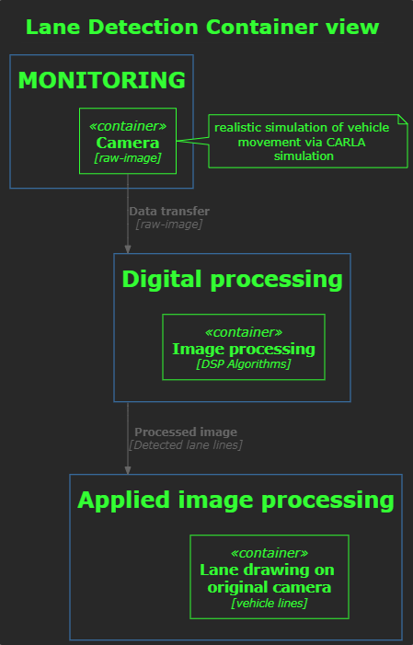
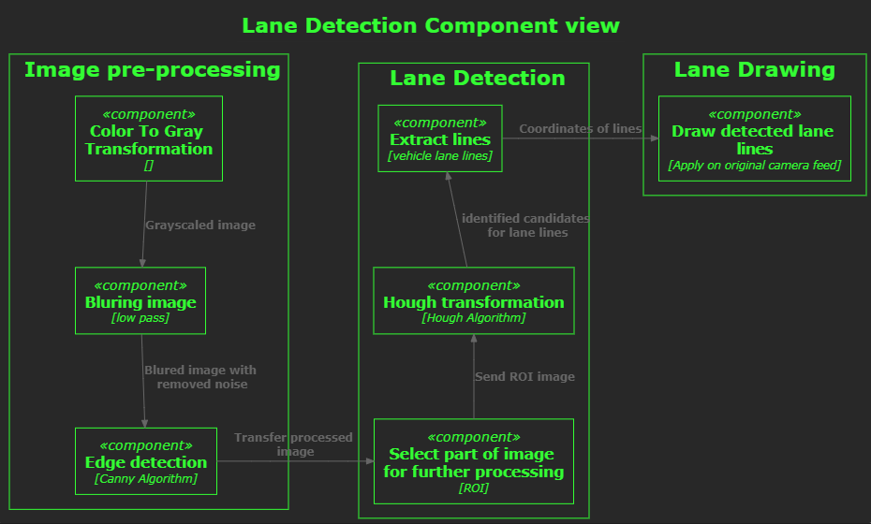
plantUML

Slide 11
Thanks for your attention ☺

